Slide 1
LINKED LIST

Slide 2
Introduction
A linked list is a linear collection of data elements called nodes in which linear representation is given by links from one node to the next node.
Linked list is a data structure which in turn can be used to implement other data structures. Thus, it acts as building block to implement data structures like stacks, queues and their variations.
A linked list can be perceived as a train or a sequence of nodes in which each node contains one or more data fields and a pointer to the next node.

Slide 3
Simple Linked List
START
1
2
3
4
5
6
7
X
In the above linked list, every node contains two parts - one integer and the other a pointer to the next node.
The left part of the node which contains data may include a simple data type, an array or a structure.
The right part of the node contains a pointer to the next node (or address of the next node in sequence).
The last node will have no next node connected to it, so it will store a special value called NULL.

Slide 4

Linked Lists
list elements are stored, in memory, in an arbitrary order
explicit information (called a link) is used to go from one element to the next

Slide 5
Memory Layout
Layout of L = (a,b,c,d,e) using an array representation.
a
b
c
d
e
A linked representation uses an arbitrary layout.
c
a
e
d
b
Notes:
The figures show computer memory. An array uses a contiguous chunk of memory.

Slide 6

Linked Representation
c
a
e
d
b
first
pointer (or link) in e is NULL
use a variable first to get to the first element a

Slide 7
Normal Way To Draw A Linked List
first
NULL
a
b
c
d
e
link or pointer field of node
data field of node

Slide 8
Chain
first
NULL
a
b
c
d
e
A chain is a linked list in which each node represents one element.
There is a link or pointer from one element to the next.
The last node has a NULL (or 0) pointer.

Slide 9
Node Representation
typedef struct Listnode
{
char data;
struct node *link;
} listNode;
link
data

Slide 10
get(0)
first
NULL
a
b
c
d
e
desiredNode = first; // gets you to first node
return desiredNode−>data;
Notes:
Move to desired node. Note that desired node may not exist. Once you are at the desired node, you can return the element in that node as in
return desiredNode.element;
When firstNode = null, there is no element whose index is 0.

Slide 11
get(1)
first
NULL
a
b
c
d
e
desiredNode = first−>link; // gets you to second node
return desiredNode−>data;
Notes:
Node that desiredNode may not exist!

Slide 12
get(2)
first
NULL
a
b
c
d
e
desiredNode = first−>link−>link; // gets you to third node
return desiredNode−>data;
Notes:
Note that desiredNode may not exist

Slide 13
get(5)
first
NULL
a
b
c
d
e
desiredNode = first−>link−>link−>link−>link−>link;
// desiredNode = NULL
return desiredNode−>data; // NULL.element
Notes:
Get an exception now as NULL->data is illegal!

Slide 14
Delete An Element
first
NULL
a
b
c
d
e
delete(0)
deleteNode = first;
first = first−>link;
free(deleteNode);
Notes:
Note that node 0 may not exist!

Slide 15
delete(2)
first
NULL
c
a
b
c
b
c
d
e
beforeNode
first get to node just before node to be removed
beforeNode = first−>link;

Slide 16
delete(2)
first
null
a
b
c
d
e
beforeNode
save pointer to node that will be deleted
deleteNode = beforeNode−>link;

Slide 17
delete(2)
first
null
a
b
c
d
e
beforeNode
now change pointer in beforeNode
beforeNode−>link = beforeNode−>link−>link;
free(deleteNode);

Slide 18
insert(0,’f’)
first
NULL
f
a
b
c
d
e
newNode
Step 1: get a node, set its data and link fields
MALLOC( newNode, sizeof(*newNode));
newNode->data = ‘f’;
newNode->link = first >link;
Notes:
First, do a checkIndex.

Slide 19
insert(0,’f’)
first
NULL
f
a
b
c
d
e
newNode
Step 2: update first
first = newNode;

Slide 20
insert(3,’f’)
first
newNode
f
NULL
a
b
c
c
d
e
beforeNode
first find node whose index is 2
next create a new node and set its data and link fields
finally link before Node to newNode

Slide 21
insert(3,’f’)
first
newNode
f
NULL
a
b
c
c
d
e
beforeNode
beforeNode = first−>link−>link;
MALLOC( newNode, sizeof(*newNode));
newNode->data = ‘f’;
newNode->link = beforeNode->link;
beforeNode−>link = newNode;

Slide 22

Chain With Header Node
headerNode
NULL
a
b
c
d
e
Notes:
Now insert/erase at left end (I.e., index = 0) are no different from any other insert/delete. So insert/delete code is simplified.

Slide 23
Empty Chain With Header Node
headerNode
NULL

Slide 24

Circular List
firstNode
a
b
c
d
e
Notes:
Useful, for example, when each node represents a supplier and you want each supplier to be called on in round-robin order. Other applications seen later. A variant of this has a header node—circular list with header node. When you don’t have a header node, it is often useful to have a last node pointer rather than a first node pointer. By doing this, additions to the front and end become O(1).

Slide 25

Doubly Linked List
firstNode
lastNode
NULL
NULL
a
b
c
d
e
Notes:
Can be used to reduce worst-case run time of a linear list add/remove/get by half. Start at left end if index <= listSize/2; otherwise, start at right end.

Slide 26
Doubly Linked Circular List
firstNode
a
b
c
d
e

Slide 27
Doubly Linked Circular List With Header Node
headerNode
a
b
c
d
e

Slide 28
Empty Doubly Linked Circular List With Header Node
headerNode

Slide 29
Insertion in a singly Linked List
There can be four cases while inserting a node in a linked list.
Insertion at the beginning.
Insertion in an empty list.
Insertion at the end.
Insertion in between the list nodes.

Slide 30
To insert a node, initially we will dynamically allocate space.
Suppose tmp is a pointer that points to this dynamically allocated node.
In the info part of the node we will put the data value.
tmp = (struct node *) malloc(sizeof(struct node)) ;
tmp->info = data

Slide 31
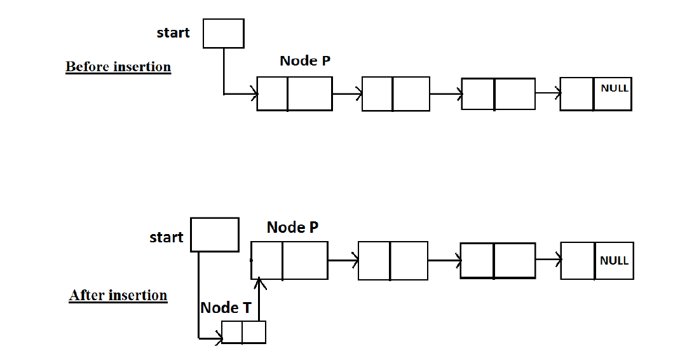
Insertion at the beginning of the list

Slide 32
We have to insert node T at the beginning of the list.
Suppose the first node of list is node P
The new node T should be inserted before it.

Slide 33
Link of Node T should contain the address of Node P
Start has the address of node P
we should write
tmp->link = start;
After this statement, link of node T will point to node P.
We want to make node T the first node; hence we should update start so that now it points to node T.
start = tmp;

Slide 34
struct node *addatbeg(struct node *start , int data)
{
struct node *tmp;
tmp = (struct node *) malloc ( sizeof ( struct node)) ;
tmp->info = data;
tmp->link = start;
start = tmp;
return start;
}/* End of addatbeg() */

Slide 35
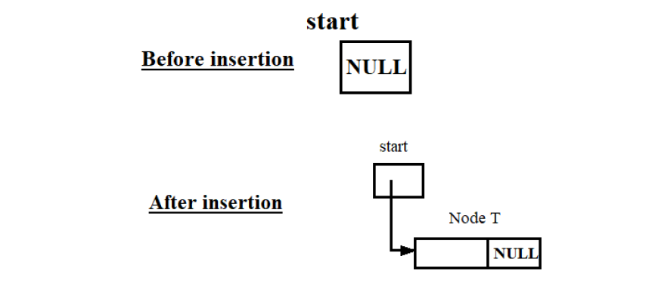
Insertion in an empty list

Slide 36
When the list is empty, value of start will be NULL.
The new node that we are adding will be the only node in the list. Since it is first node, start should point to this node and it is also the last node so its link should be NULL
tmp->link = NULL;
start = tmp;
Since initially start was NULL, we can write start instead of NULL in the first statement
these two statements can be written as -
tmp->link = start;
start = tmp;

Slide 37
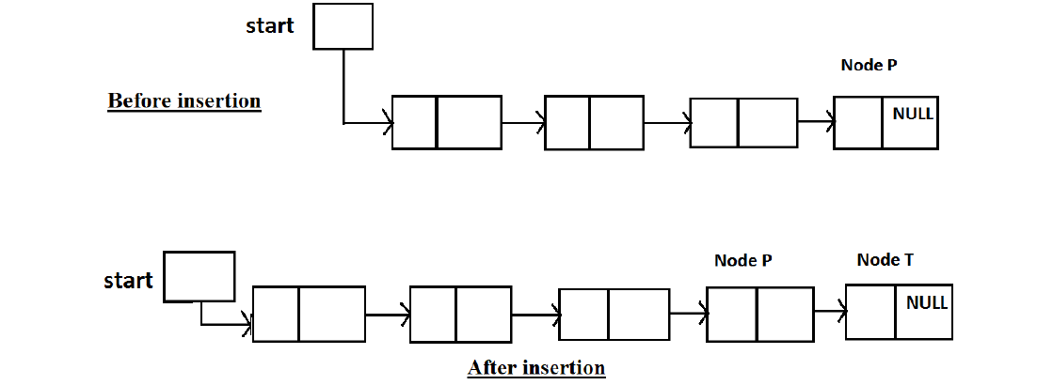
Insertion at the end of the list

Slide 38
Suppose P is the Pointer pointing to node P
These two statements should be written for insertion
p->link = tmp;
tmp->link = NULL;
So in this case we should have a pointer p pointing to the last node of the list. The only information about the linked list that we have is the pointer start.
p = start;
while(p->link!=NULL)
p = p->link;
terminating condition is (p->link!=NULL).

Slide 39
struct node *addatend (struct node * start , int data)
{
struct *p, *tmp;
tmp = (struct node *) malloc ( sizeof ( struct node)) ;
tmp->info = data;
p = start;
while(p->link!=NULL)
p = p->link;
p->link = tmp;
tmp->link = NULL;
return start;
}/* End of addatend() */

Slide 40
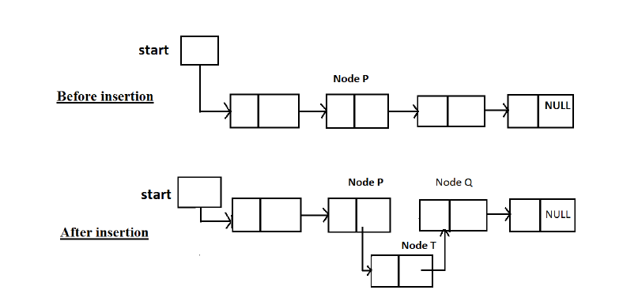
Insertion in between the list nodes

Slide 41
Suppose we have two pointers p and q pointing to nodes P and Q respectively. The two statement should be written for insertion of node T are –
tmp->link = q;
p->link = tmp;
Before insertion address of node Q is in p->link , so instead of pointer q we can write p->link .Now the two statement for insertion can be written as-
tmp->link = p->link;
p->link = tmp;

Slide 42
Three cases of insertion in between the nodes-
Insertion after a node
Insertion before a node
Insertion at a given position

Slide 43
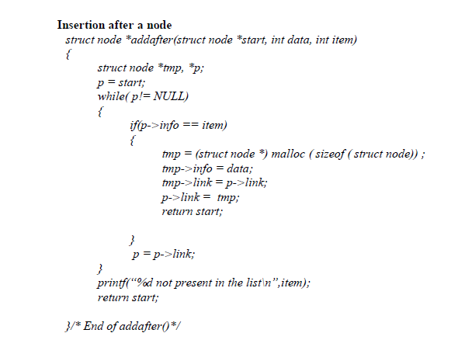

Slide 44
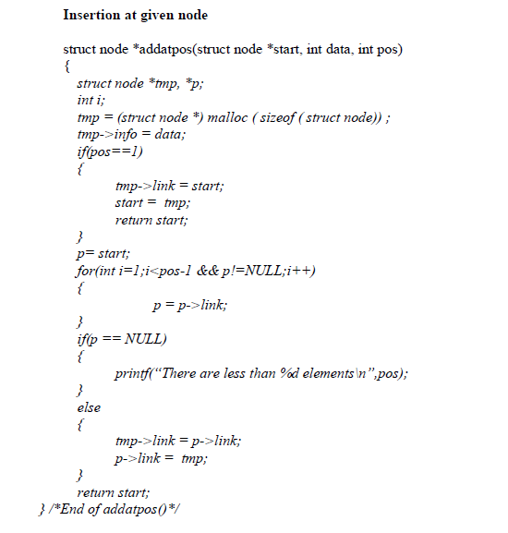

Slide 45
Deletion in a Single Linked List
There can be four cases while inserting a node in a linked list.
Deletion of first node.
Deletion of the only node.
Deletion in between the list.
Deletion at the end.

Slide 46
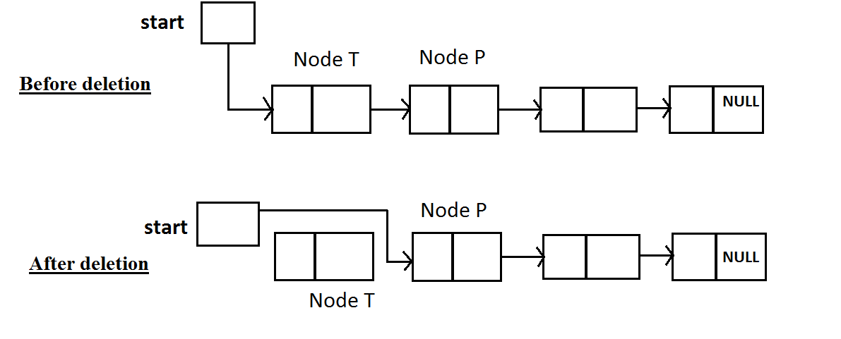
Deletion of first node

Slide 47
In all the cases we should call free (tmp)
to physically remove T From the memory ode
Node to be deleted is the first node
tmp will be assigned the address of the first node.
tmp = start;
So now tmp points to the first node.
start = start->next;
After this statement, start points to node P so now it is the first node of the list.

Slide 48
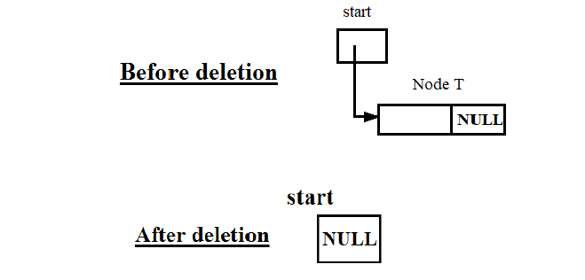
Deletion of the only node
tmp = start;
start = NULL;
In the second statement, we can write start->link instead of NULL.

Slide 49
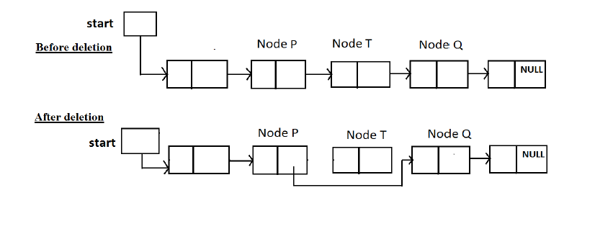
Deletion in between the list nodes

Slide 50
Suppose node T to be deleted and pointer tmp points to it .
We have pointers p and q which points to node P and Q respectively.
For deletion of node T we will just link the predecessor of T(node P) to successor of T(node Q).
p->link = q;
The address of q is stored in tmp->link so instead of q we can write tmp->link in the above statement.
p->link = tmp->link;

Slide 51
The value to be deleted is in node T and we need a pointer to its predecessor which is node P, so as addbefore() our condition for searching will be if(p->link->info == data).
p = start;
while(p->link!=NULL)
{
if(p->link->info == data)
{
tmp = p->link;
p->link = tmp->link;
free(tmp);
}
return start;
}

Slide 52
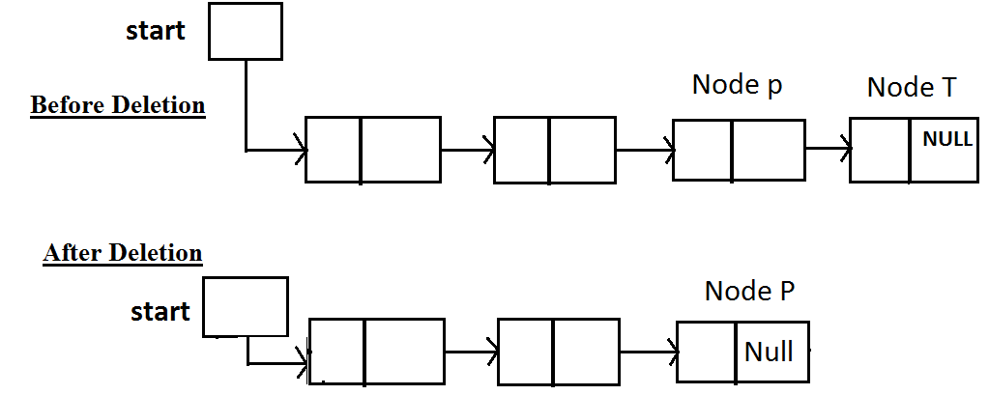
Deletion at the end of the list.

Slide 53
If P is pointer to node P then T can be deleted by writing
p->link = NULL;
since link of node T is NULL.
p->link = tmp->link;

Slide 54
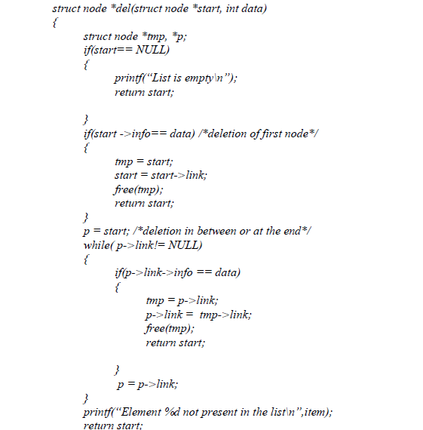

Slide 55
Reversing a Single Linked List
The following changes need to be done in a single linked list for reversing it.
First node should become the last node of linked list.
Last node should become the first node of linked list and now start should point to it.
Link of 2nd node should point to 1st node, link of 3rd node should point to 2nd node and so on.

Slide 56
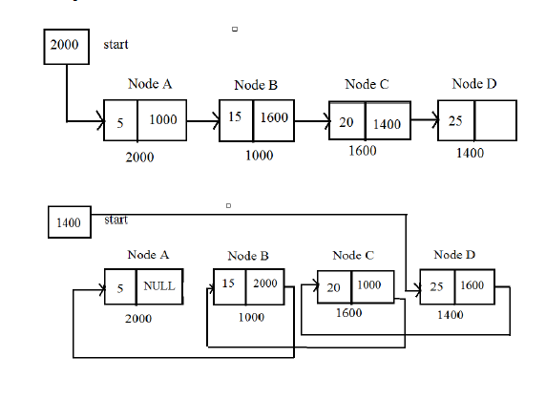

Slide 58
Reversal of a linked list(iterative version)
struct Node
{
int data;
struct Node* next;
};
struct Node * head;
void reverse()
{
struct Node* current,*prev,*next;
current=head;
prev=NULL;
while(current!=NULL)
{
next=current->next;
current->next=prev;
prev=current;
current=next;
}
head =prev;
return head;
}

Slide 59
Reversal of a linked list(recursive version)
struct Node
{
int data;
struct Node* next;
};
struct Node*head;
void reverse(struct Node *p)
{
if (p->next == NULL)
{
head=p;
return;
}
reverse(p->next);
struct Node* q=p->next;
q->next=p;
p->next=NULL;
}
}

Slide 60
struct node *reverse( struct node *start)
{
struct node *prev, *ptr, *next;
prev =NULL;
ptr= start;
while(ptr!=NULL)
{
next = ptr ->next;
ptr->link = prev;
prev=ptr;
ptr=next;
}
start = prev;
return start;
}/*end of reverse*/

Slide 61
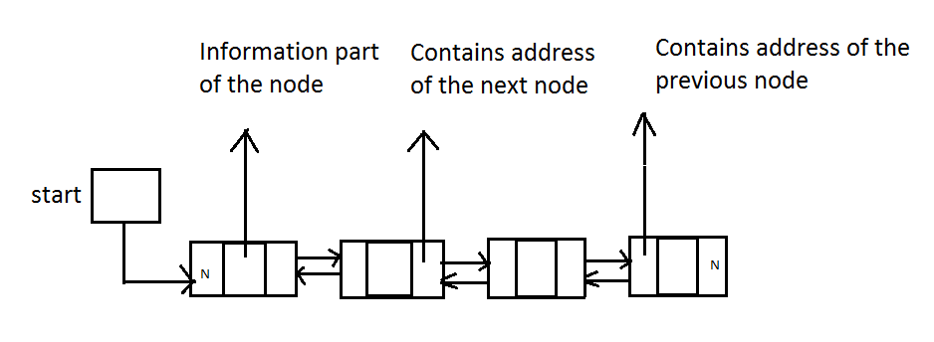

Slide 62
Insertion in a double linked list
Insertion at the beginning of the lists.
Insertion in a empty linked list.
Insertion at the end of the list.
Insertion in between the nodes.

Slide 63
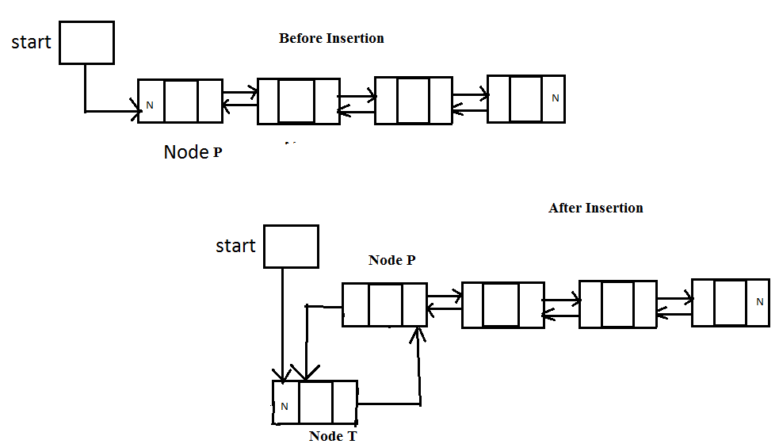
Insertion at the beginning of the lists.

Slide 64
struct node *addatbeg ( struct node *start, int data )
{
struct node *tmp ;
tmp = ( struct node * ) malloc ( sizeof ( struct node ) ) ;
tmp->info=data;
tmp-> prev = NULL;
tmp-> next = start ;
start -> prev = tmp;
start=tmp;
return start;

Slide 65
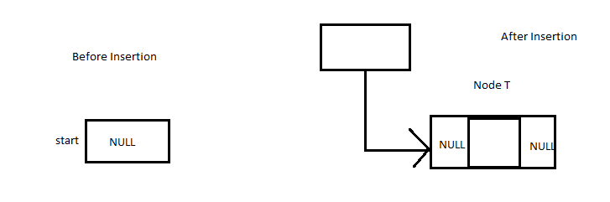
Insertion in an empty linked list

Slide 66
struct node *addtoempty ( struct node *start, int data )
{
struct node *tmp ;
tmp = ( struct node * ) malloc ( sizeof ( struct node ) ) ;
tmp->info=data;
tmp-> prev = NULL;
tmp-> next = NULL ;
start=tmp;
return start;
}

Slide 67
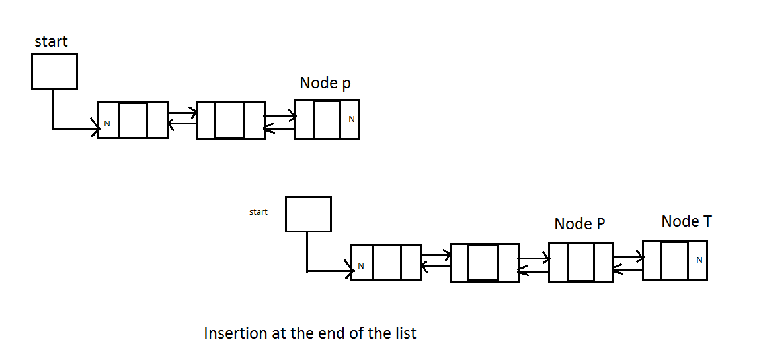
3. Insertion at the end of the list.

Slide 68
struct node *addatend ( struct node *start, int data )
{
struct node *tmp ,*p;
tmp = ( struct node * ) malloc ( sizeof ( struct node ) ) ;
tmp->info=data;
p=start;
while(p->next!=NULL)
p=p->next;
p-> next = tmp ;
temp-> next =NULL;
temp -> prev = p;
return start;
}

Slide 69
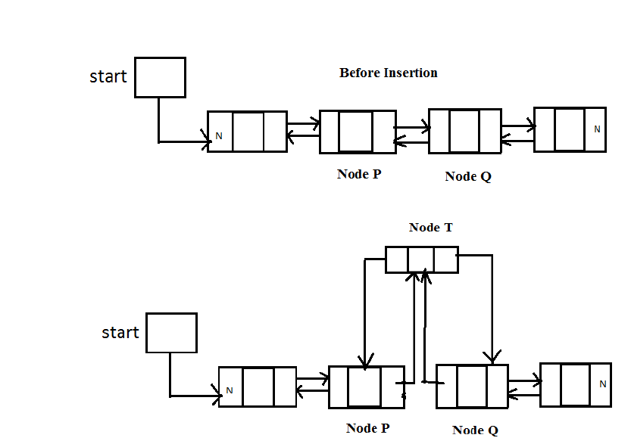
Insertion in between the nodes.

Slide 70
struct node *addafter ( struct node *start, int data, int item )
{
struct node *tmp ,*p;
tmp = ( struct node * ) malloc ( sizeof ( struct node ) ) ;
tmp->info=data;
p=start;
while(p!=NULL)
{
If(p->info==item)
{ temp-> prev = p ;
temp-> next =p->next;
if(p-.next!=NULL)
p->next->prev=tmp;
p->next=tmp;
return start;
}
p=p->next;
}
printf(“%d do not present in the list\n”,item);
return start;
}

Slide 71
Deletion from doubly linked list
Deletion of first node
Deletion of the only node
Deletion in between the nodes
Deletion at the end of the list.
( SELF STUDY)
Write code Yourself)

